Slide 1
Understanding Relationships
English Lesson Plan (A2 Level)

Slide 2
Lesson Objectives
English
Uzbek
• Identify common types of relationships.
• Learn new vocabulary related to relationships.
• Discuss personal experiences with different relationships.
• Munosabatlarning umumiy turlarini aniqlash.
• Munosabatlarga oid yangi lug'at so'zlarini o'rganish.
• Turli munosabatlar haqidagi shaxsiy tajribalarni muhokama qilish.

Slide 3
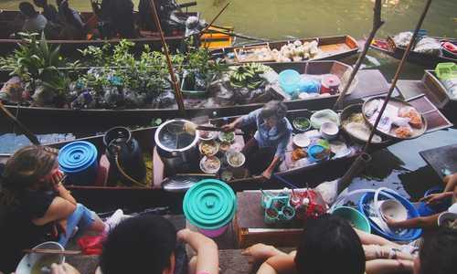
Vocabulary
friend / do'st
Someone you like and spend time with.
Image related to the word

Slide 4

Vocabulary
family / oila
People related to you, like parents, siblings.
Image related to the word

Slide 5

Vocabulary
colleague / hamkasb
Someone you work with.
Image related to the word

Slide 6

Vocabulary
neighbor / qo'shni
Someone who lives next to you.
Image related to the word

Slide 7

Vocabulary
relationship / munosabat
How two or more people are connected.
Image related to the word

Slide 8

Vocabulary
trust / ishonch
Believing someone is honest and good.
Image related to the word

Slide 9
Activities
Warm-up:
Ask students: 'What makes a good friend?' Students discuss in pairs for 3 minutes.
Controlled Practice:
Matching activity: Provide vocabulary words and simple definitions. Students match the words with their correct definitions. Example: 'Friend' - 'Someone you like and spend time with.'
Freer Practice:
Discussion questions: 1. What types of relationships are important in your life? 2. How do you maintain good relationships with your family and friends? 3. What do you usually do with your friends or family members?
Boshlanish:
Talabalardan so'rang: 'Yaxshi do'stni nima tashkil qiladi?' Talabalar juftlikda 3 daqiqa davomida muhokama qilishadi.
Nazoratli Mashq:
Moslashtirish mashqi: Lug'at so'zlari va oddiy ta'riflarni bering. Talabalar so'zlarni to'g'ri ta'riflari bilan moslashtiradilar. Misol: 'Do'st' - 'Siz yoqtiradigan va birga vaqt o'tkazadigan odam.'
Erkin Mashq:
Muhokama savollari: 1. Hayotingizda qanday munosabatlar muhim? 2. Oila a'zolaringiz va do'stlaringiz bilan yaxshi munosabatlarni qanday saqlaysiz? 3. Do'stlaringiz yoki oila a'zolaringiz bilan odatda nima qilasiz?

Slide 10
Reading Passage
English
Uzbek
Relationships are very important in life. I have many good friends. We often go to the cinema or study together. My family is also very important. I live with my parents and two sisters. We always help each other. At university, I have many colleagues. We work on projects together. It's good to have strong relationships with people around you. They make life happier and more interesting.
Munosabatlar hayotda juda muhim. Mening ko'plab yaxshi do'stlarim bor. Biz tez-tez kinoga boramiz yoki birga o'qiymiz. Oilam ham juda muhim. Men ota-onam va ikki singlim bilan yashayman. Biz har doim bir-birimizga yordam beramiz. Universitetda ko'plab hamkasblarim bor. Biz loyihalar ustida birga ishlaymiz. Atrofingizdagi odamlar bilan mustahkam munosabatda bo'lish yaxshi. Ular hayotni baxtliroq va qiziqarliroq qiladi.

Slide 11
Comprehension Questions
English
Uzbek
1. Who does the writer live with?
2. What do the writer and their friends often do together?
3. Why are strong relationships important according to the text?
1. Yozuvchi kimlar bilan yashaydi?
2. Yozuvchi va uning do'stlari tez-tez birga nima qilishadi?
3. Matnga ko'ra, mustahkam munosabatlar nima uchun muhim?

Slide 12
Conclusion
English
Uzbek
Ask students to share one new thing they learned about relationships today or one way they can improve a relationship in their own lives.
Talabalardan bugun munosabatlar haqida o'rgangan bir yangi narsani yoki o'z hayotlaridagi munosabatni yaxshilashning bir usulini aytishlarini so'rang.

Slide 13
Thank You!

