Slide 1









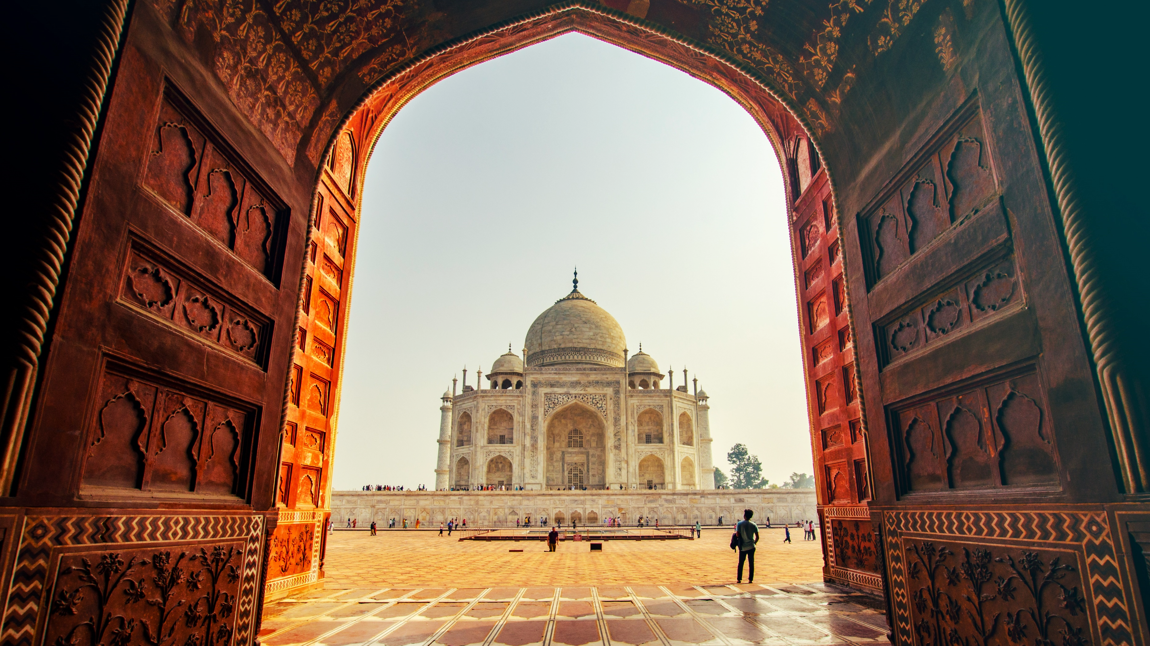
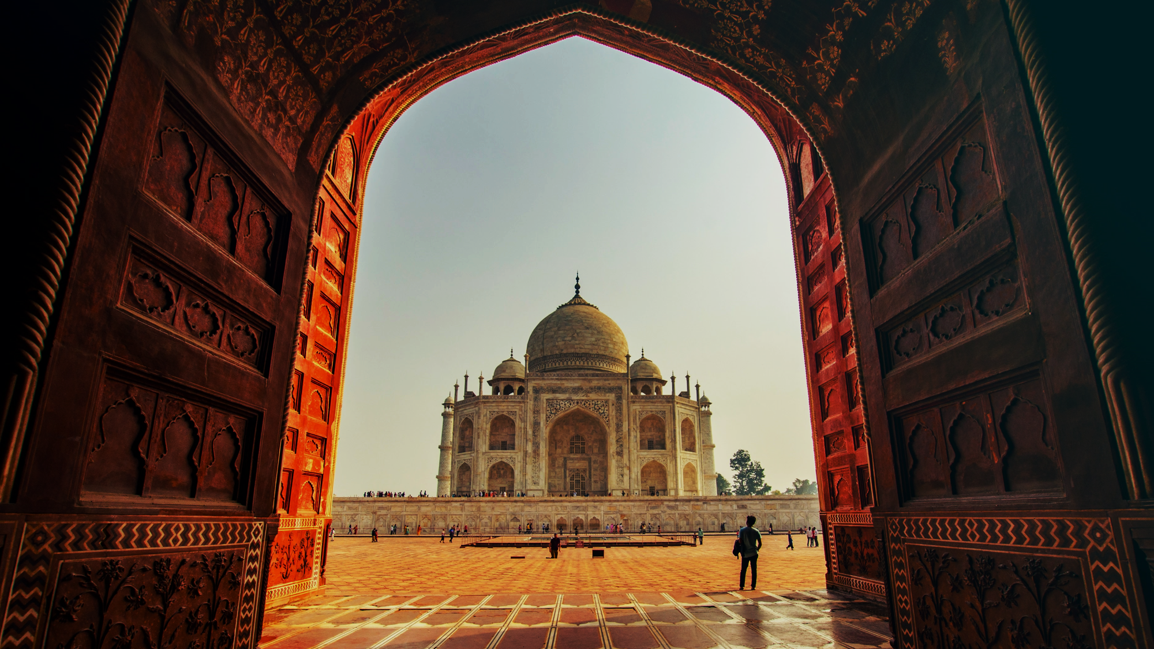
Incredible India
Welcome
Geography
History
Culture
Religion
Cuisine
Architecture
Wildlife
Economy
Tourism
Notes:
https://unsplash.com/photos/people-near-taj-mahal-eU4pipU_8HA

Slide 2


Incredible India
Welcome
Geography
History
Culture
Religion
Cuisine
Architecture
Wildlife
Economy
Tourism
Welcome
Get ready to immerse yourself in the vibrant and diverse culture of India. From bustling cities to serene landscapes, India has something for everyone.
Notes:
https://unsplash.com/photos/people-near-taj-mahal-eU4pipU_8HA

Slide 3


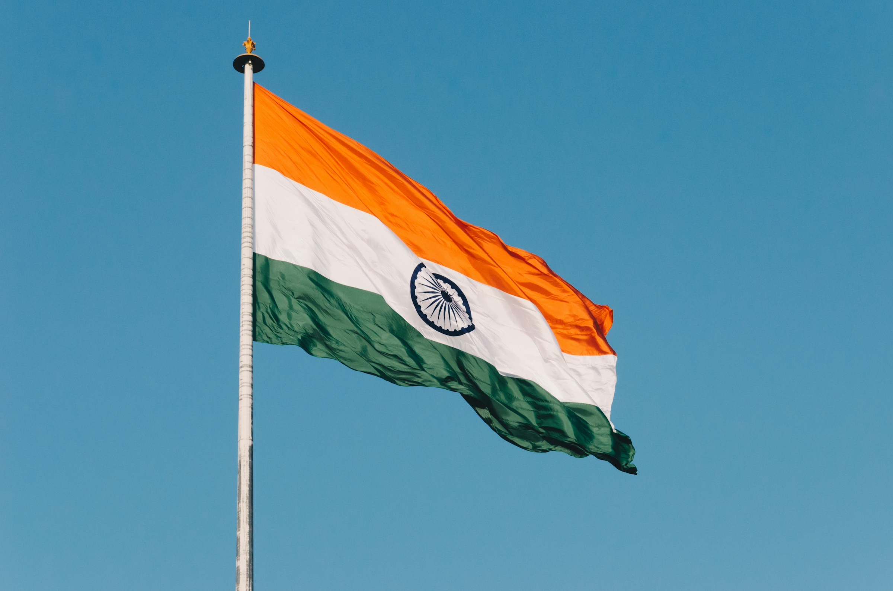
Incredible India
Welcome
Geography
History
Culture
Religion
Cuisine
Architecture
Wildlife
Economy
Tourism
Geography
India is a vast subcontinent located in South Asia, bordered by the Indian Ocean to the south, the Arabian Sea to the southwest, and the Bay of Bengal to the southeast.
Notes:
https://unsplash.com/photos/flag-hanging-on-pole-9Dt4WutvwDs

Slide 4

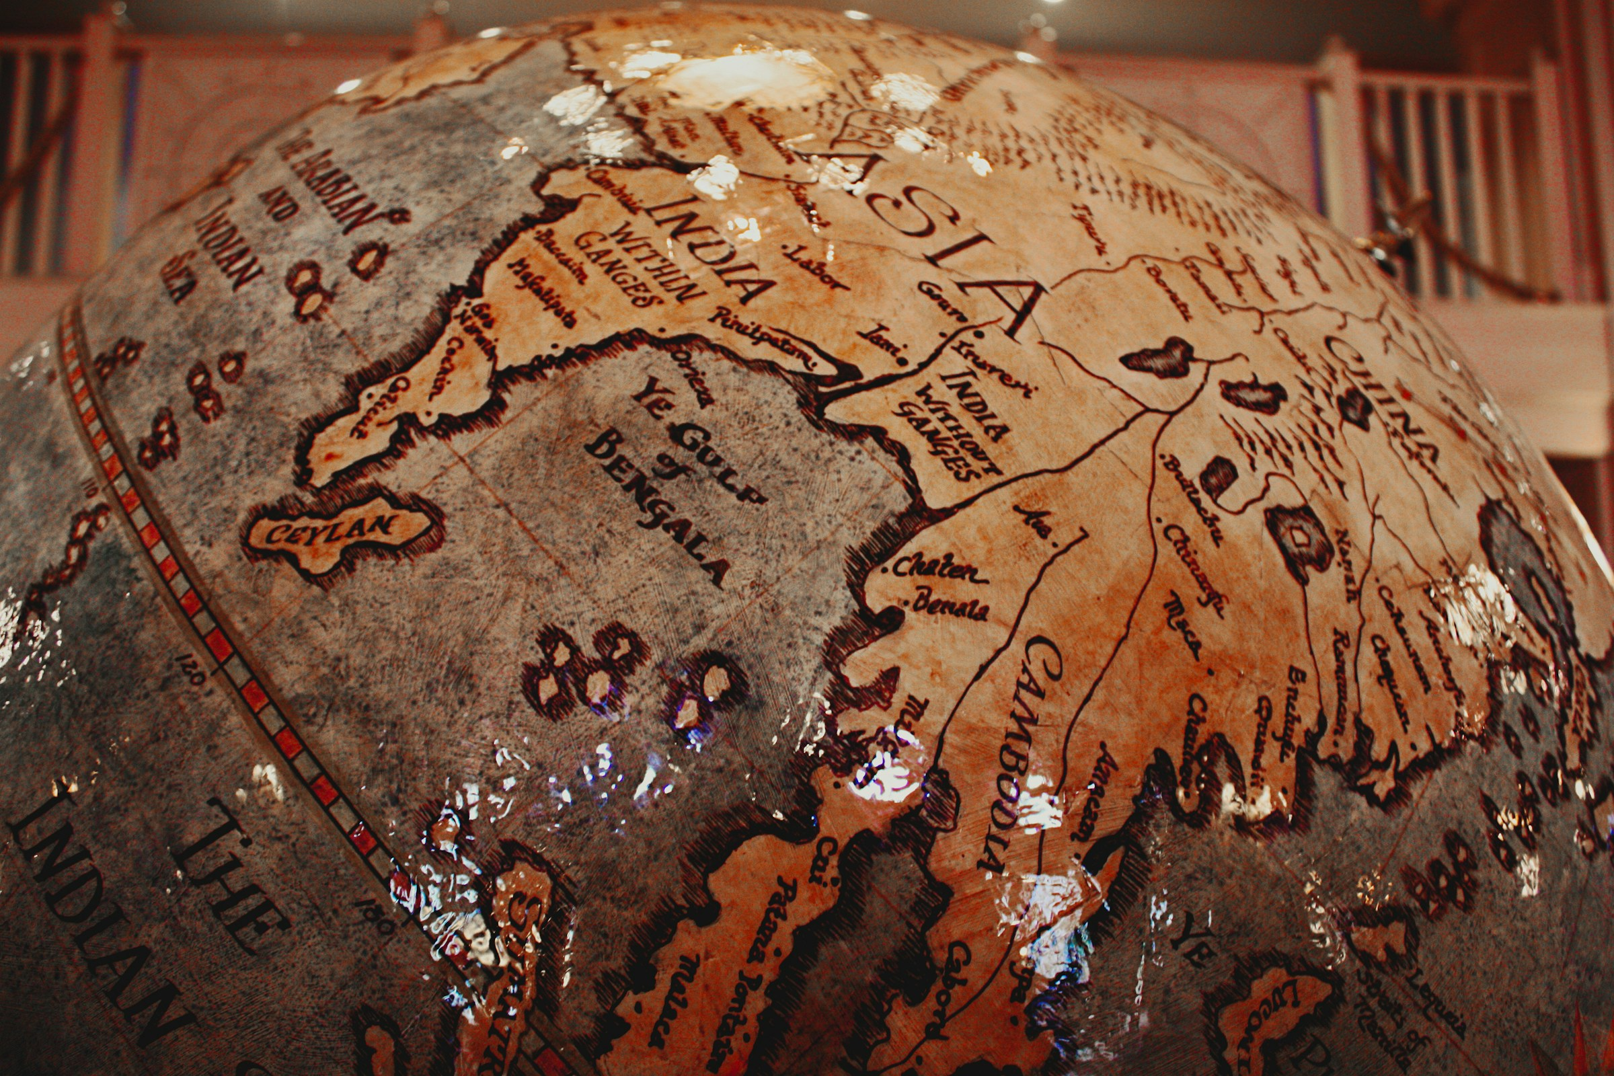
Incredible India
Welcome
Geography
History
Culture
Religion
Cuisine
Architecture
Wildlife
Economy
Tourism
History
India boasts a storied history spanning thousands of years, with civilizations dating back to the Indus Valley Civilization. From the Maurya and Gupta empires to the Mughal and British colonial periods, India's history is marked by a tapestry of dynasties, conquests, and cultural exchanges.
Notes:
https://unsplash.com/photos/brown-and-black-printed-textile-AdmO8NNe9gU

Slide 5

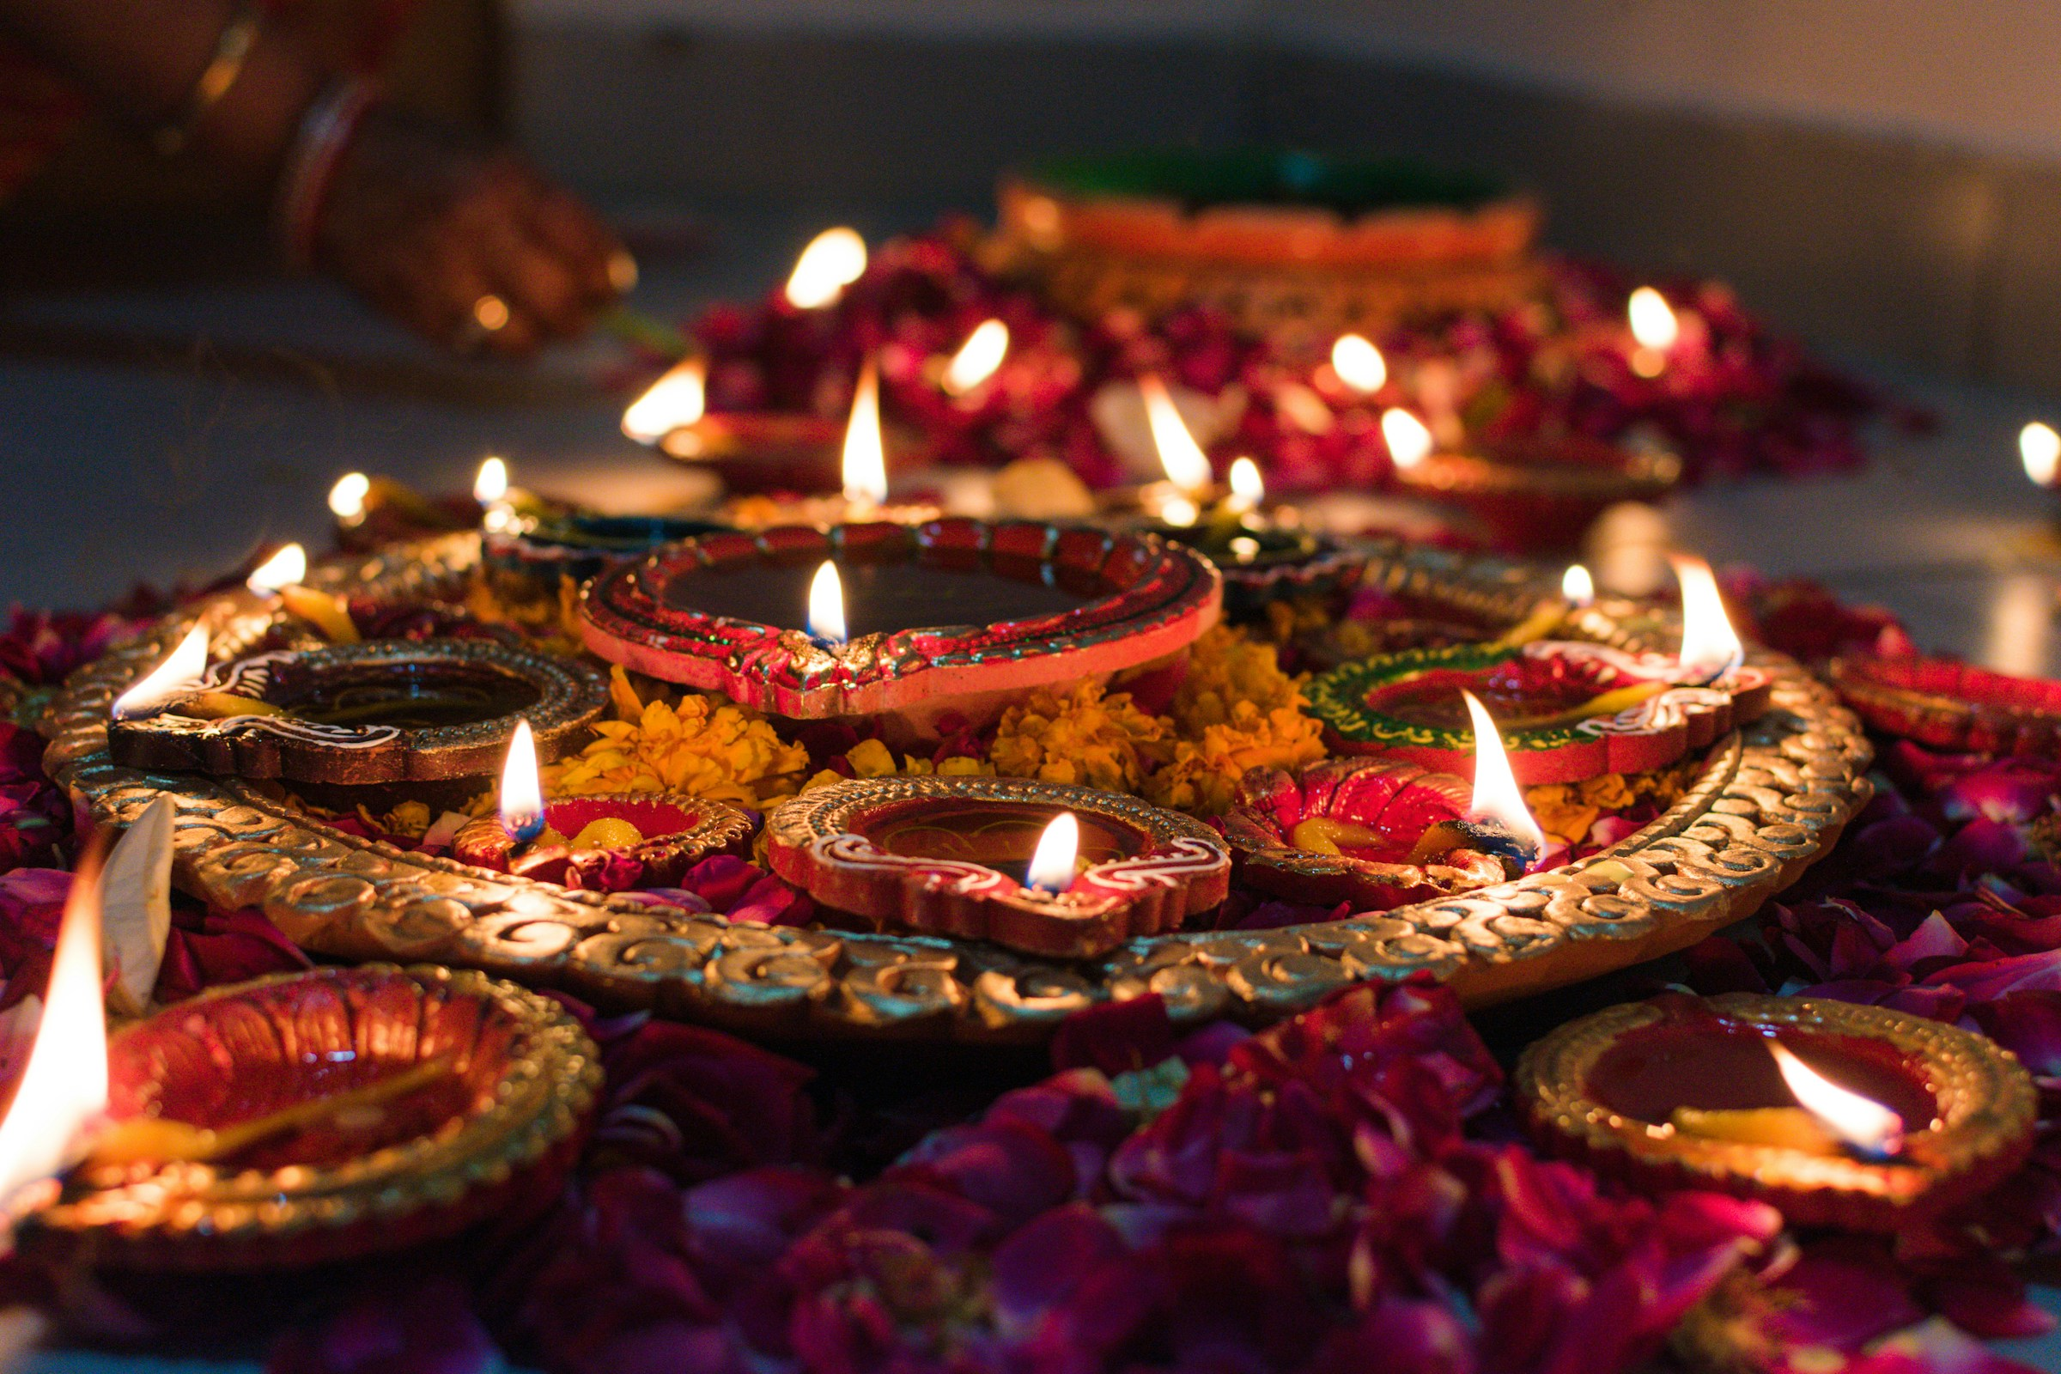
Incredible India
Welcome
Geography
History
Culture
Religion
Cuisine
Architecture
Wildlife
Economy
Tourism
Culture
Indian culture is a mosaic of traditions, languages, religions, and arts. From the colorful festivals like Diwali and Holi to classical dances like Bharatanatyam and Kathak, India's cultural landscape is as diverse as it is vibrant, reflecting the harmony of its people.
Notes:
https://unsplash.com/photos/lit-candles-xisPXJqwQkA

Slide 6

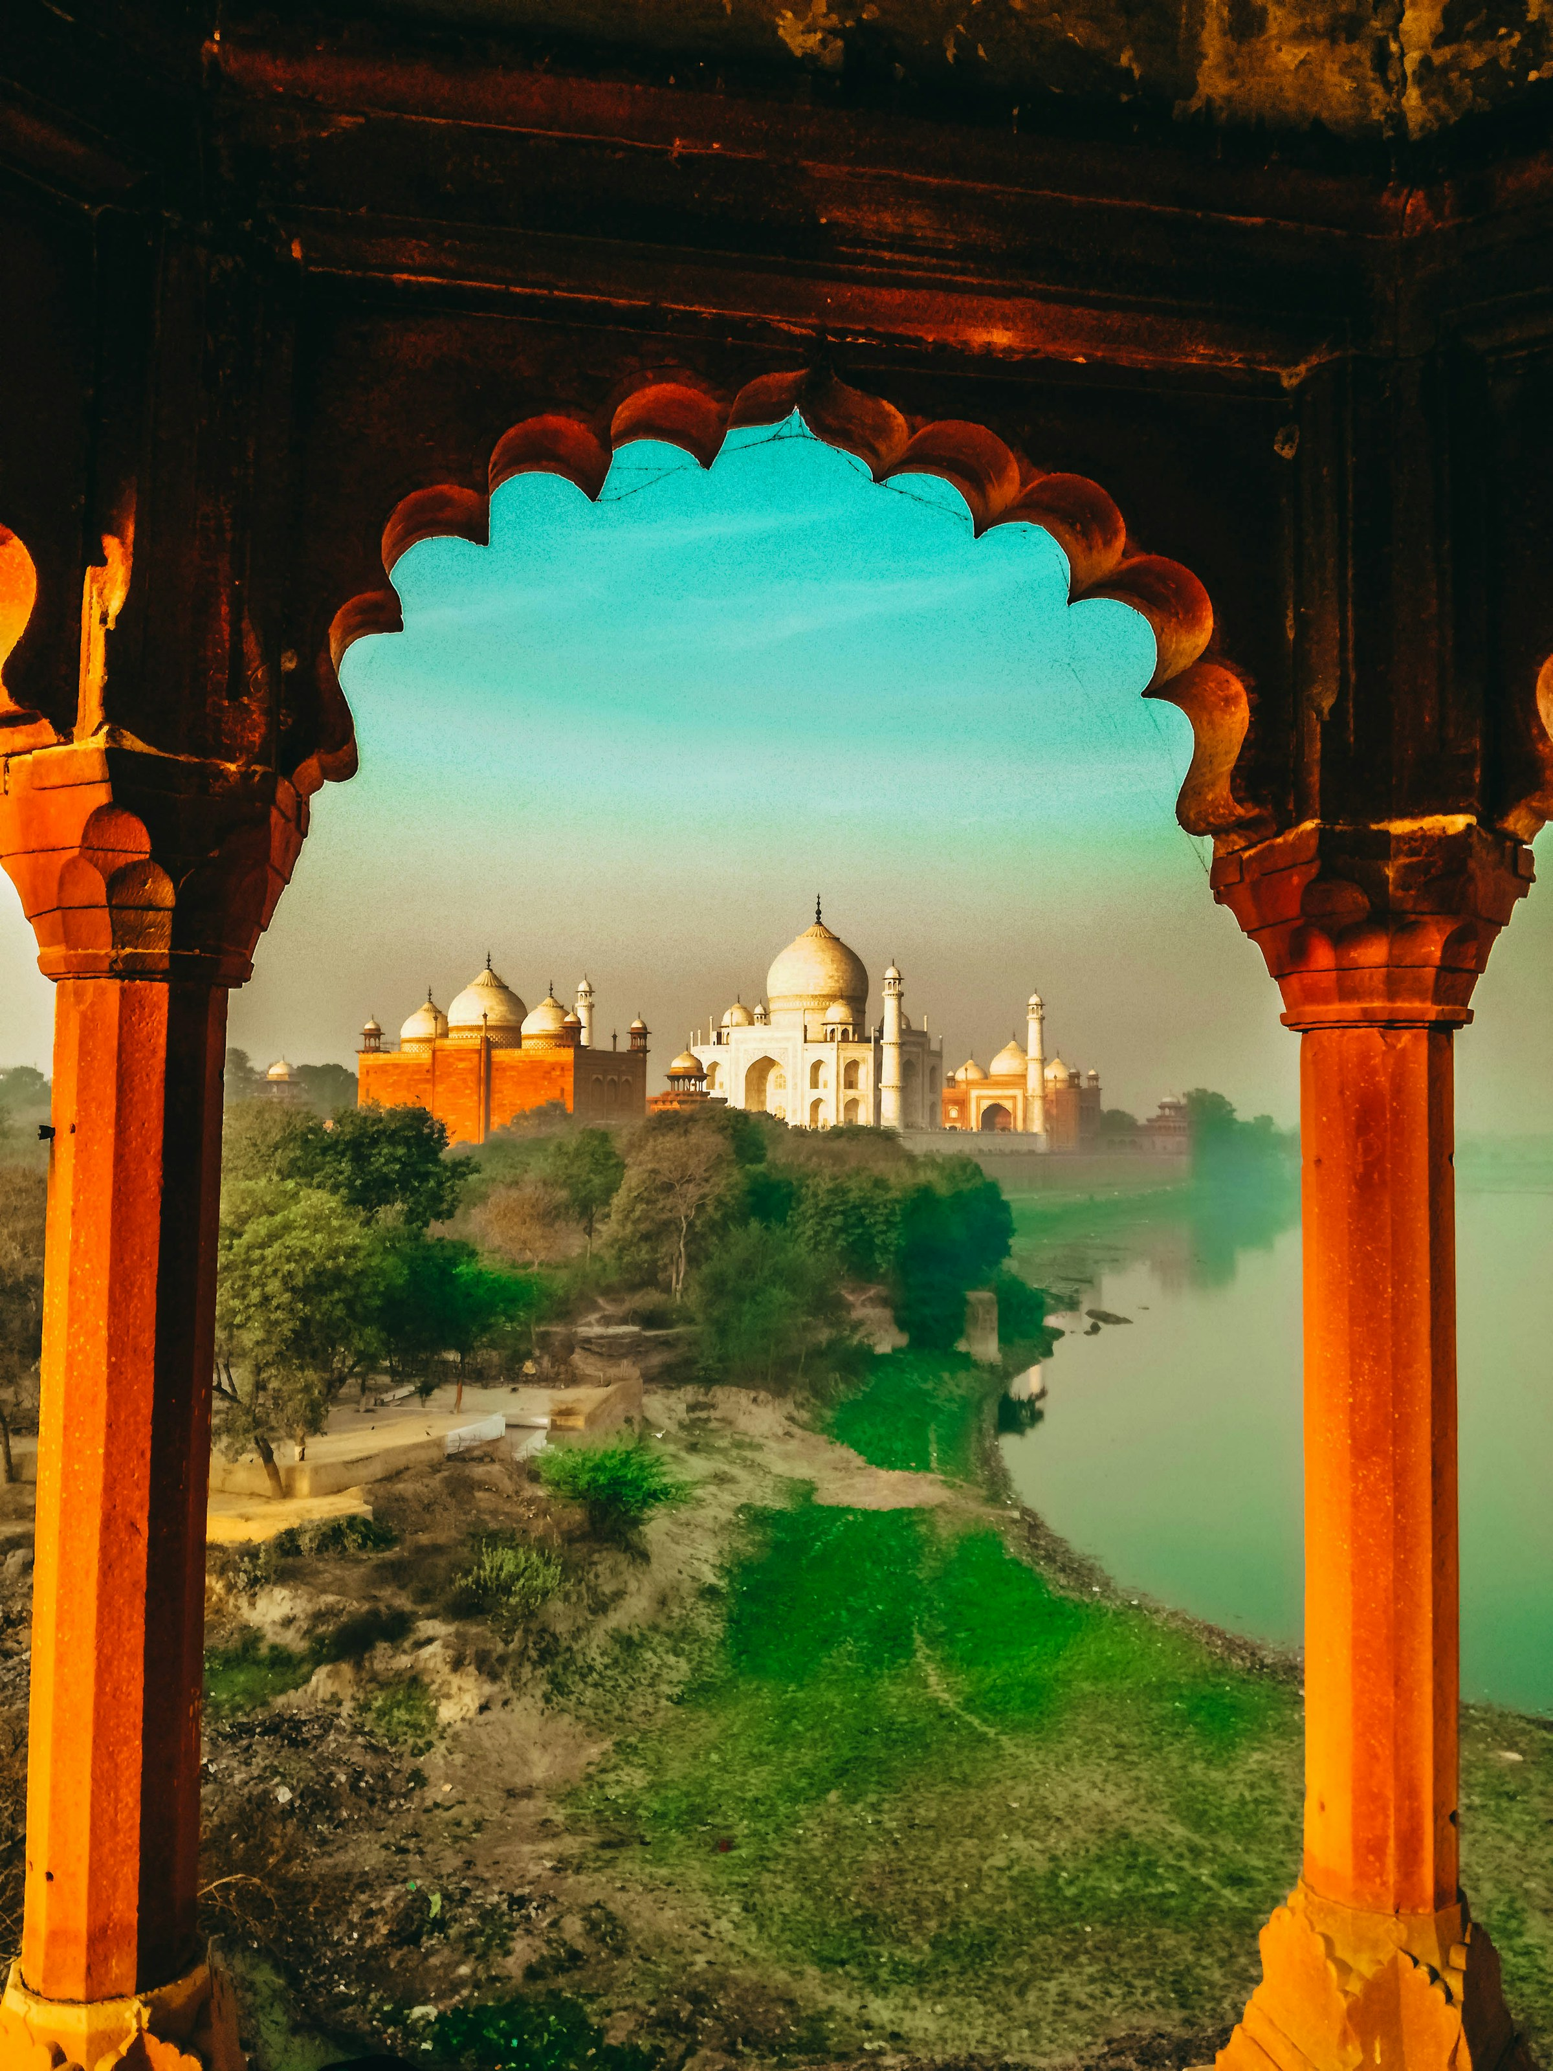
Incredible India
Welcome
Geography
History
Culture
Religion
Cuisine
Architecture
Wildlife
Economy
Tourism
Religion
India is the birthplace of several major religions, including Hinduism, Buddhism, Jainism, and Sikhism. Its spiritual heritage is woven into the fabric of daily life, with sacred sites like Varanasi, Bodh Gaya, and the Golden Temple drawing pilgrims from around the globe.
Notes:
https://unsplash.com/photos/architectural-photography-of-mosque-mwV6PsB-7Bk

Slide 7

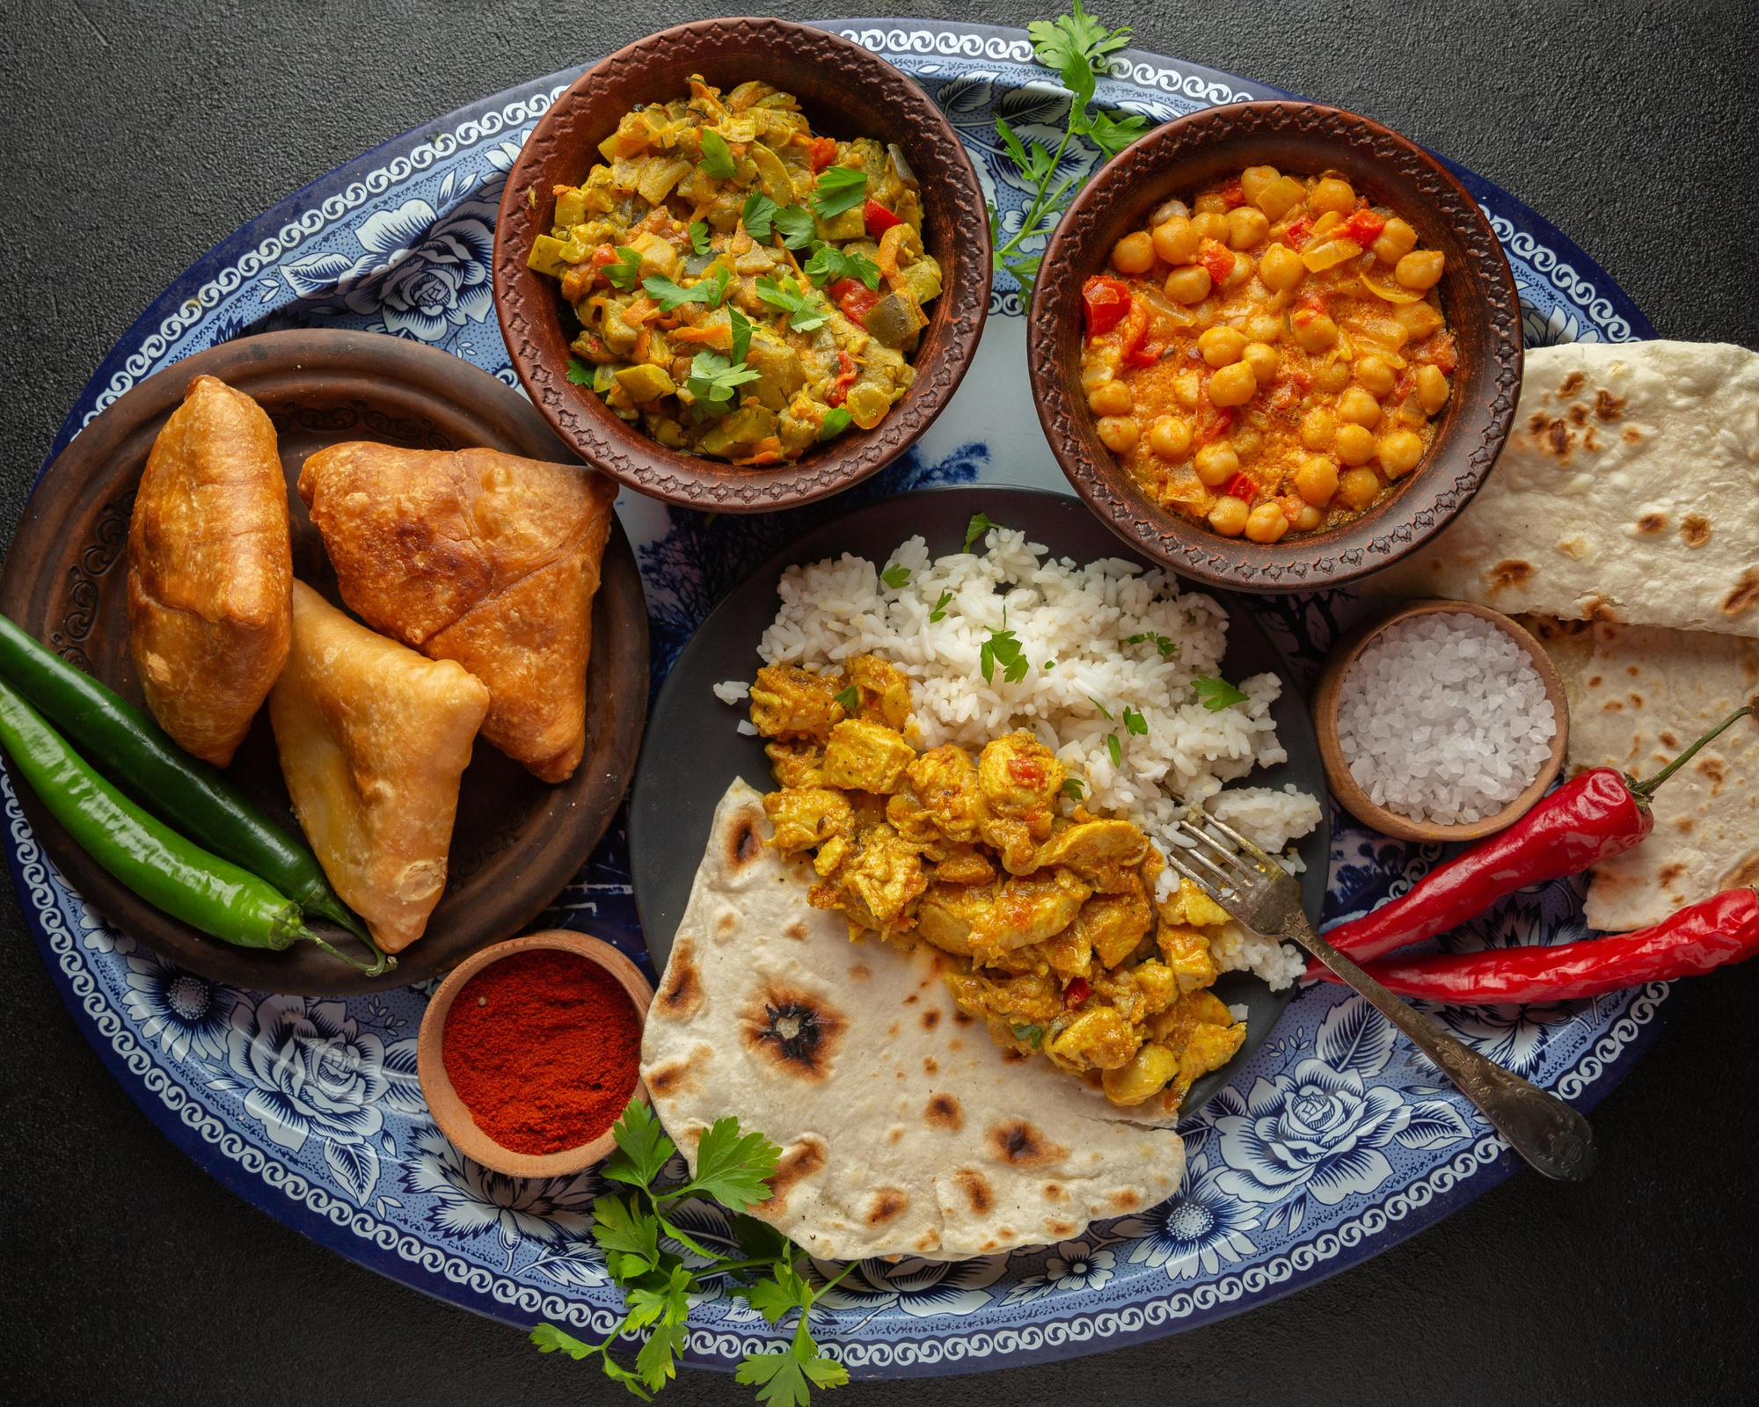
Incredible India
Welcome
Geography
History
Culture
Religion
Cuisine
Architecture
Wildlife
Economy
Tourism
Cuisine
Indian cuisine is renowned worldwide for its rich flavors, aromatic spices, and diverse regional specialties. From the fiery curries of the south to the savory kebabs of the north, every dish tells a story of tradition, heritage, and culinary mastery.
Notes:
https://www.freepik.com/free-photo/delicious-indian-food-tray_10753161.htm

Slide 8

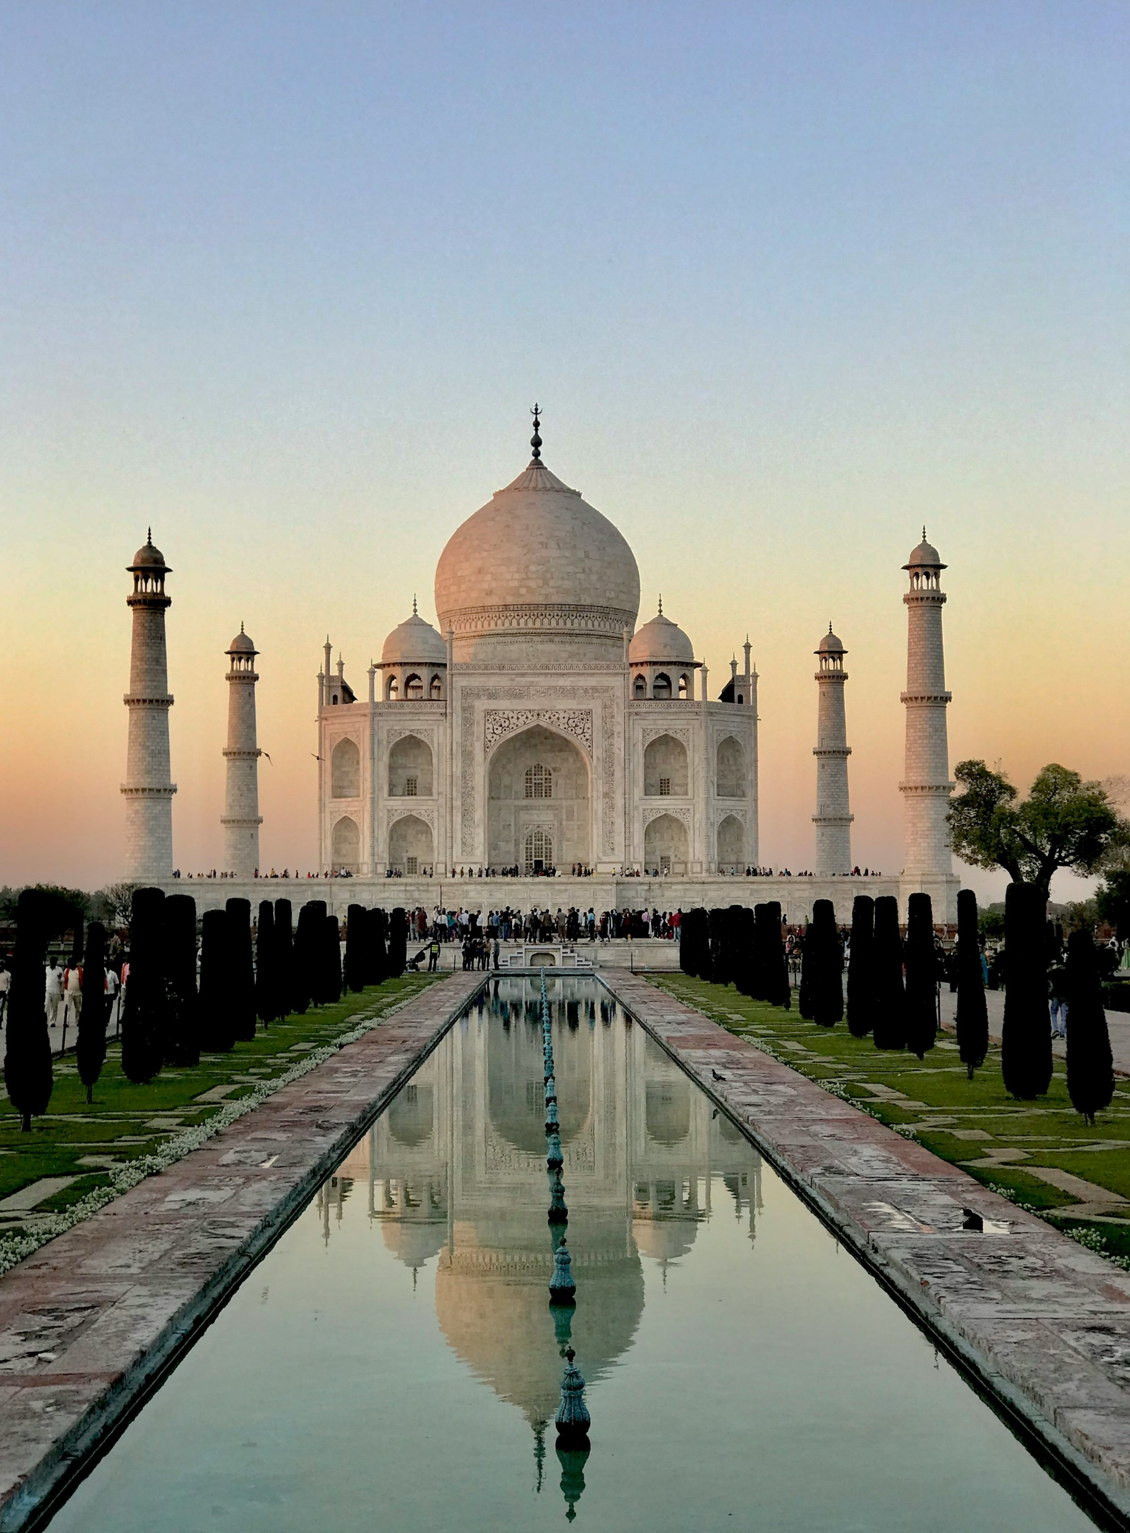
Incredible India
Welcome
Geography
History
Culture
Religion
Cuisine
Architecture
Wildlife
Economy
Tourism
Architecture
Marvel at the majestic beauty of the Taj Mahal and the intricate carvings of ancient temples. India's architectural wonders will leave you in awe.
Notes:
https://unsplash.com/photos/people-walking-near-white-concrete-building-during-daytime-p4-d9whI0Ts

Slide 9

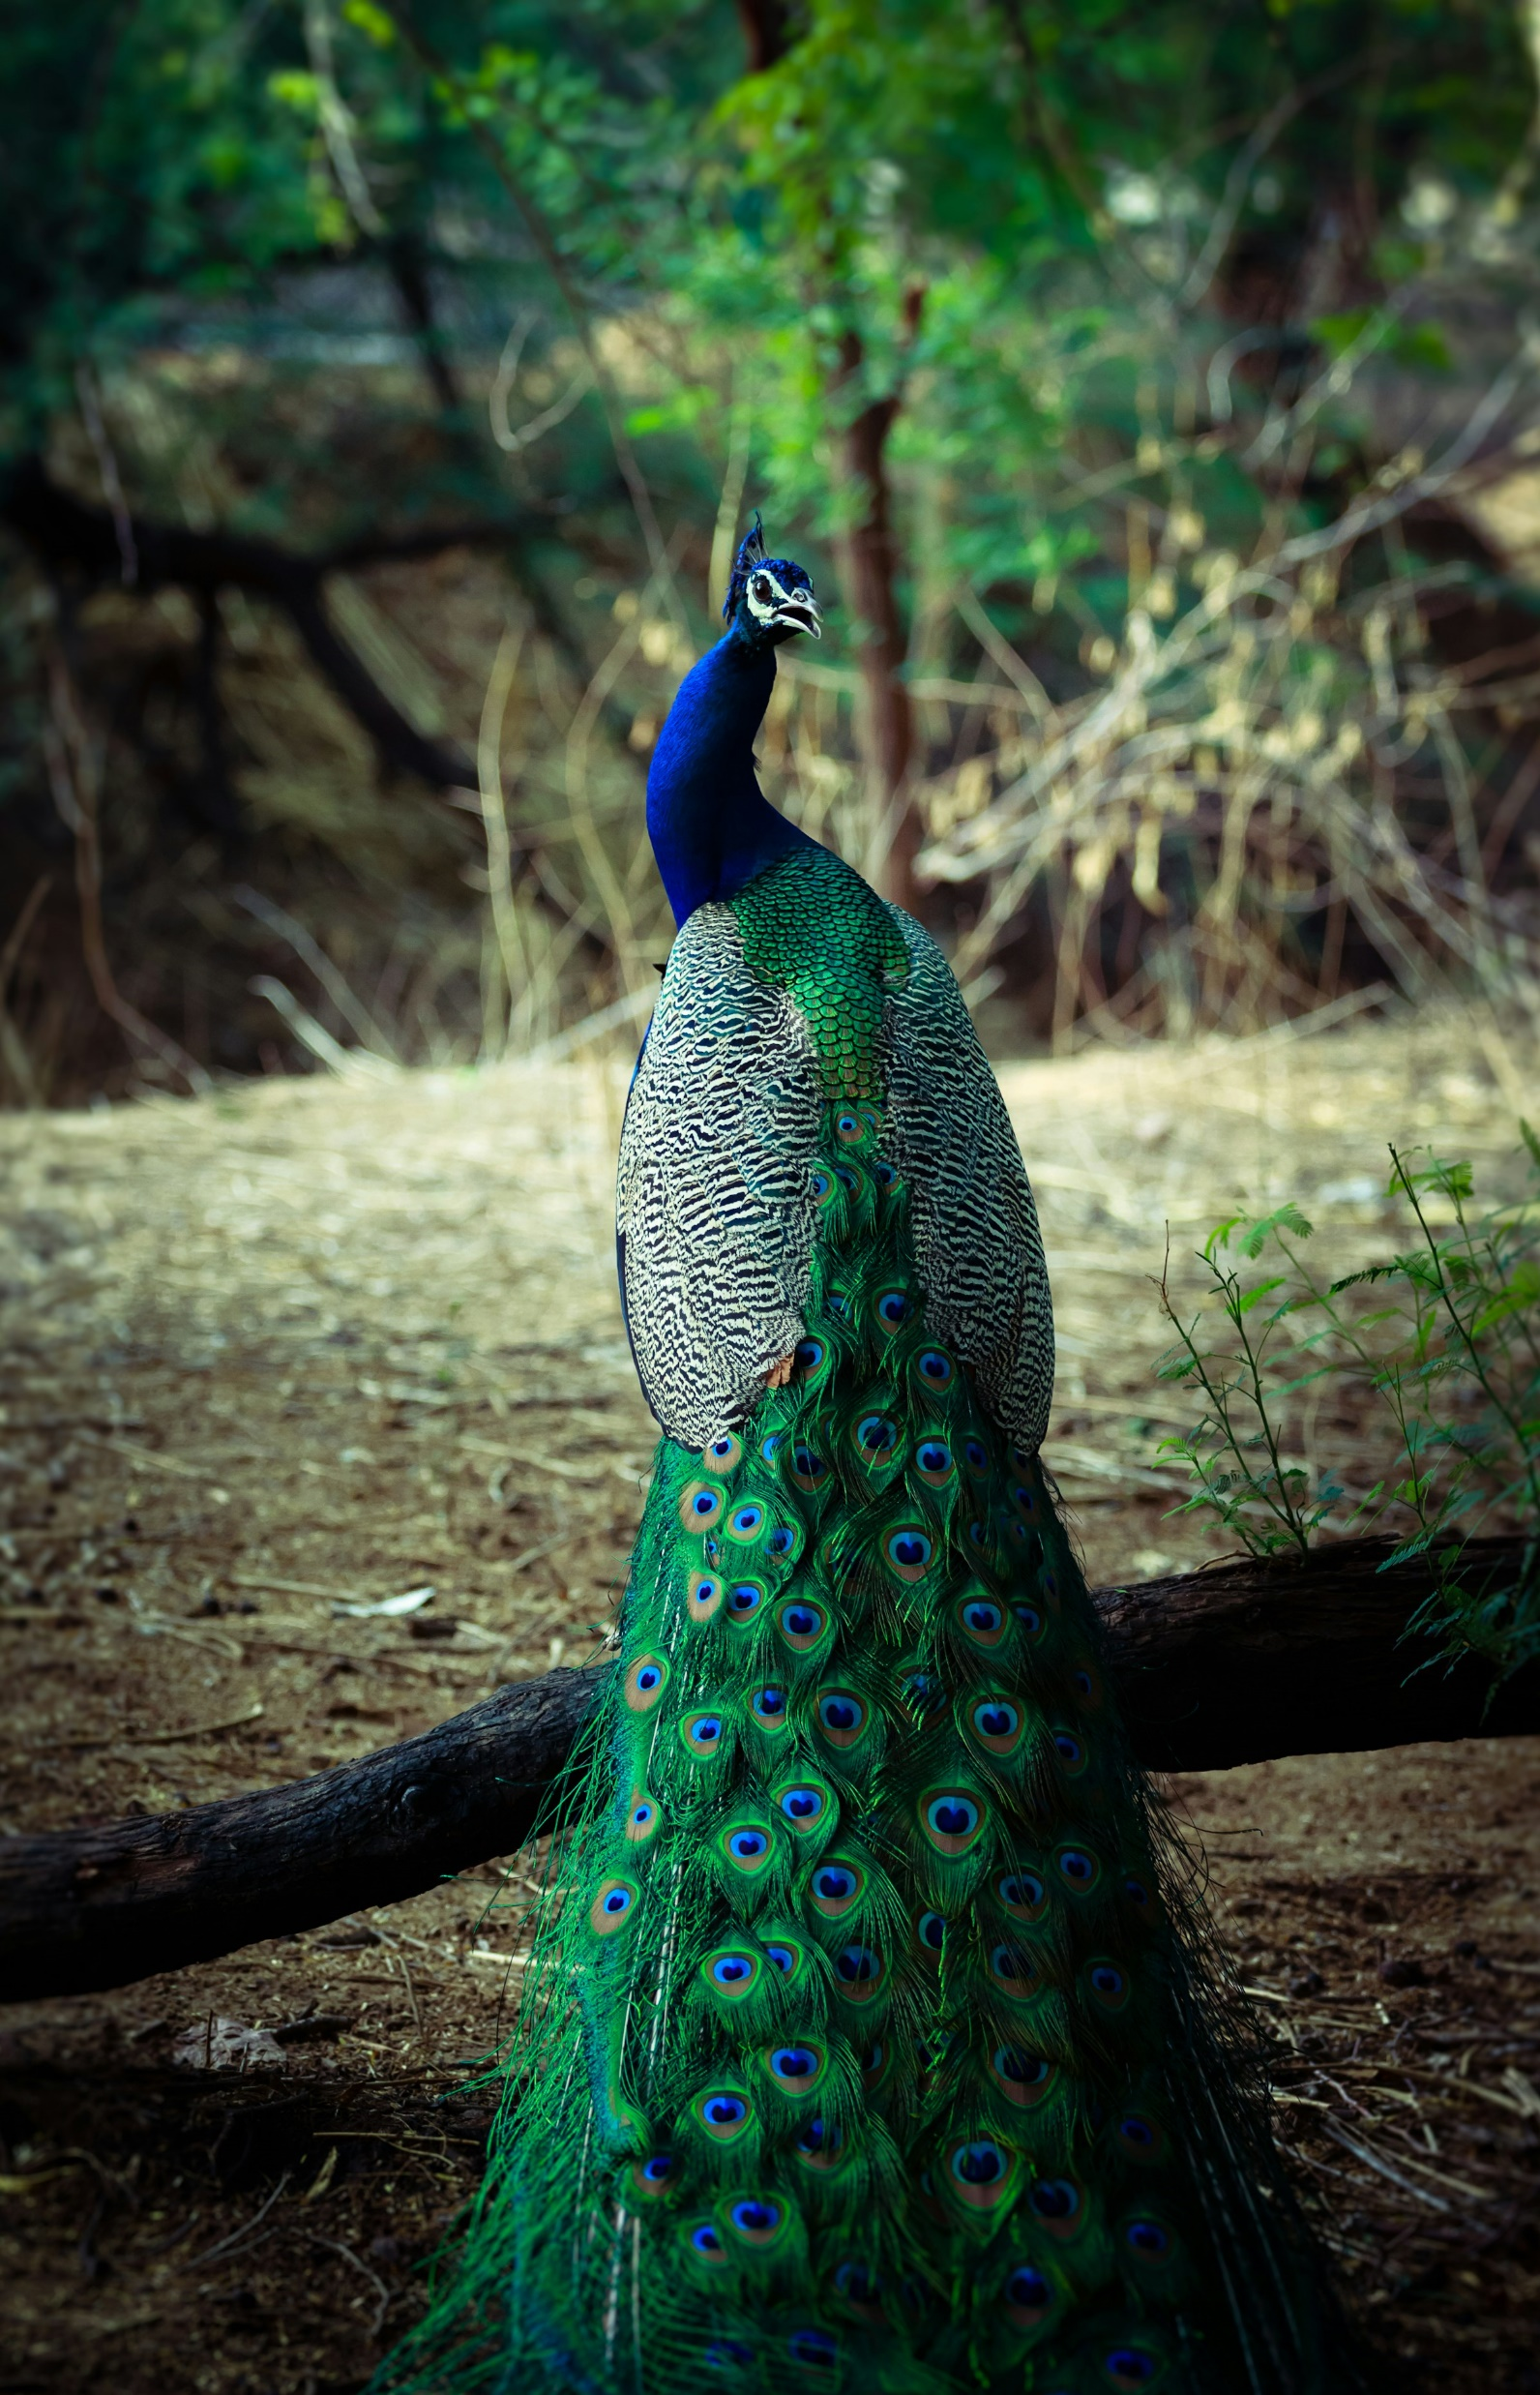
Incredible India
Welcome
Geography
History
Culture
Religion
Cuisine
Architecture
Wildlife
Economy
Tourism
Wildlife
India is a haven for biodiversity, boasting a remarkable array of wildlife species, including Bengal tigers, Asian elephants, and Indian rhinoceroses. From the lush forests of Kerala to the dry expanses of Rajasthan, India's diverse ecosystems support a wealth of flora and fauna.
Notes:
https://unsplash.com/photos/male-green-and-blue-peacock-KNOyIlIK2XE

Slide 10

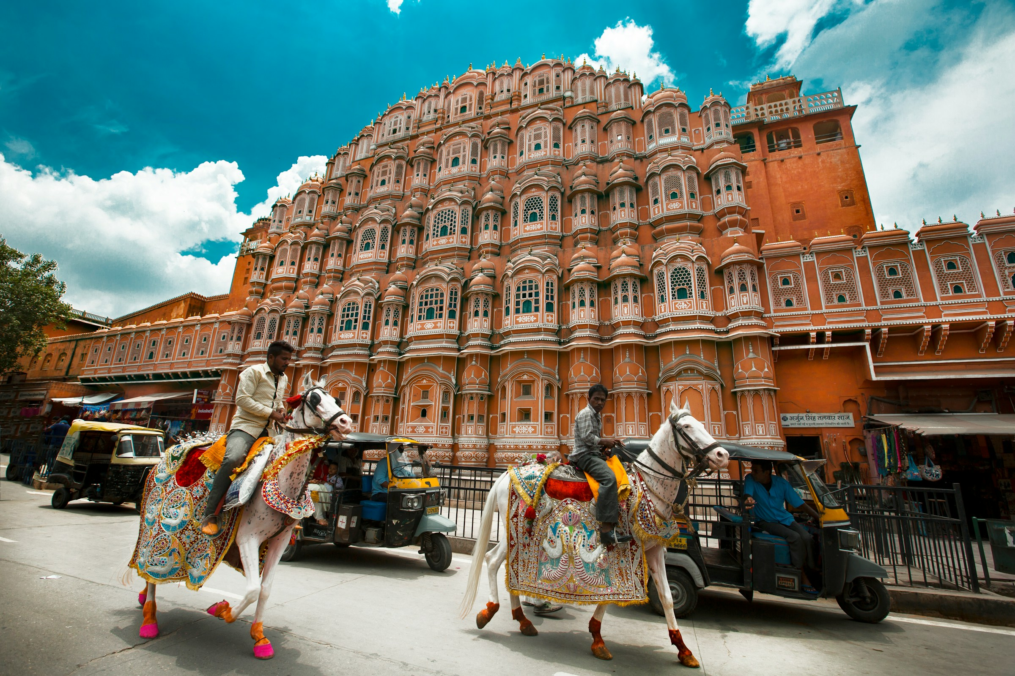
Incredible India
Welcome
Geography
History
Culture
Religion
Cuisine
Architecture
Wildlife
Economy
Tourism
Economy
India is one of the world's fastest-growing major economies, driven by a diverse mix of industries, including information technology, agriculture, and manufacturing.
Notes:
https://unsplash.com/photos/man-in-white-and-green-long-sleeve-shirt-standing-near-brown-concrete-building-during-daytime-6rDbvXzIVpQ

Slide 11

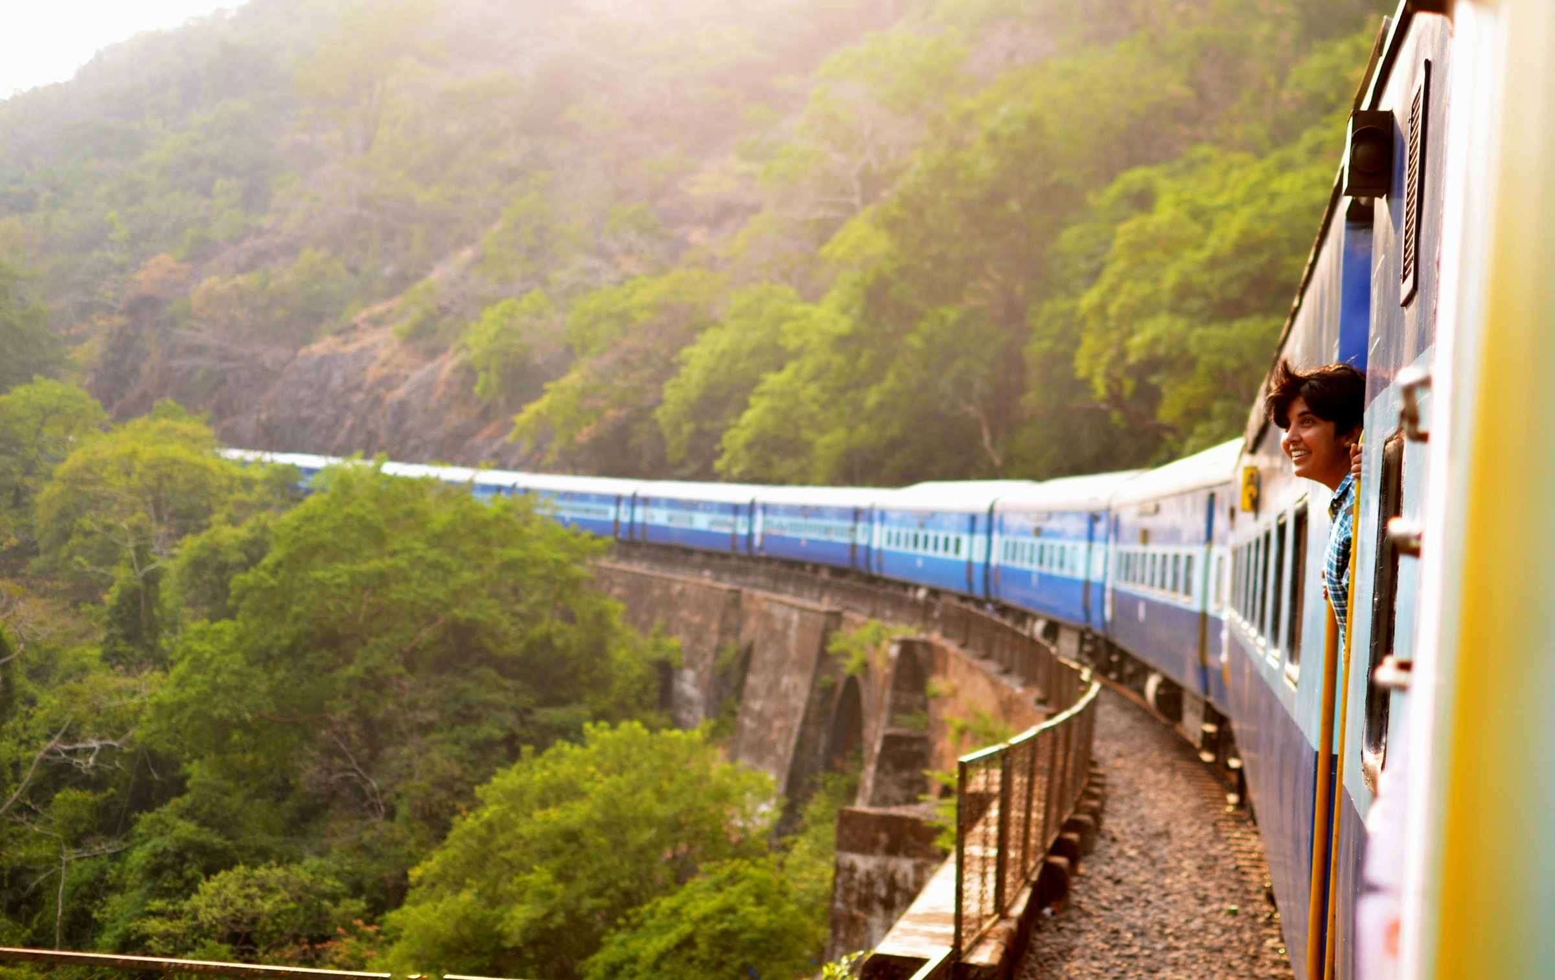
Incredible India
Welcome
Geography
History
Culture
Religion
Cuisine
Architecture
Wildlife
Economy
Tourism
Tourism
India's rich cultural heritage, stunning landscapes, and warm hospitality make it a top destination for travelers worldwide. From the iconic Taj Mahal to the serene backwaters of Kerala, India offers a myriad of experiences that captivate the senses and leave a lasting impression.
Notes:
https://unsplash.com/photos/moving-train-near-trees-gJhev0YgUcE

