Slide 1

Welcome to British Holidays!
Learn about fun UK traditions.
Simple language for everyone.
Let's explore together!

Slide 2

Christmas in the UK: Family Time
It's on December 25th.
People celebrate Jesus' birth.
It's a special family holiday.

Slide 3
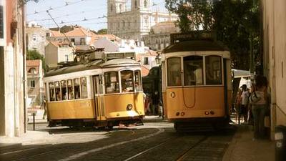
Christmas Eve and Santa
Children wait for Santa.
They hang stockings by the fire.
Presents are opened on Christmas morning.

Slide 4

Christmas Day Fun
Big dinner with turkey.
Crackers make a fun bang.
Watch the King's speech on TV.

Slide 5

Easter: Spring & New Life
Celebrated in spring.
Marks Jesus' resurrection.
Time for new beginnings.

Slide 6

Easter Fun
Children hunt for eggs.
Many eat chocolate eggs.
Some attend church services.

Slide 7

Halloween: Spooky Night!
Celebrated on October 31st.
It's a fun, spooky evening.
People dress in costumes.

Slide 8
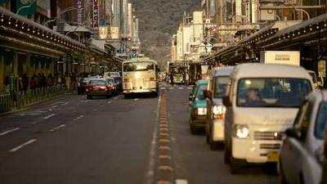
Trick or Treat!
Children ask for sweets.
Carve scary pumpkin faces.
Some tell ghost stories.

Slide 9

Guy Fawkes Night: Bonfire Night
Celebrated on November 5th.
Remember Guy Fawkes' plot.
Also called Bonfire Night.

Slide 10

Bonfires and Fireworks
Big bonfires are lit.
Enjoy bright fireworks displays.
People watch them with friends.

Slide 11

Notting Hill Carnival: London Party!
Huge street party in London.
Celebrated in August.
Caribbean culture is central.

Slide 12
Music, Dance, and Food
Enjoy vibrant music and dance.
See amazing costumes.
Taste delicious street food.

Slide 13

British Holidays: Fun for All!
Many exciting traditions.
From spooky to spectacular.
Hope you enjoyed learning!

