Slide 1
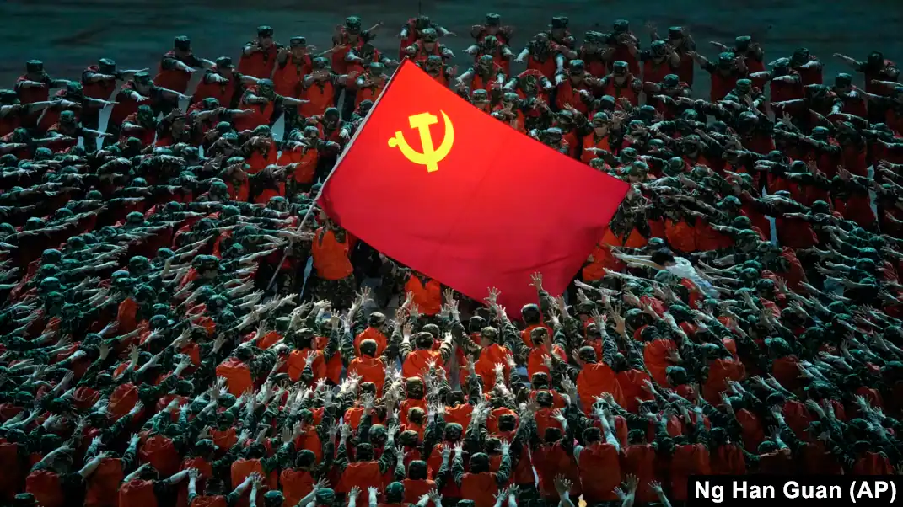
USSR
The USSR, or the Union of Soviet Socialist Republics, was a vast country that existed from 1917 to 1991. It was a communist state that spanned much of Eastern Europe and Asia. The Soviet Union was founded after the Russian Revolution of 1917, which overthrew the Tsarist monarchy. In 1991, the Soviet Union collapsed, and its constituent republics became independent countries. The collapse of the USSR was a major event in world history and marked the end of the Cold War.

Slide 2
USSR
The USSR, or the Union of Soviet Socialist Republics, was a vast country that existed from 1917 to 1991. It was a communist state that spanned much of Eastern Europe and Asia. The Soviet Union was founded after the Russian Revolution of 1917, which overthrew the Tsarist monarchy. In 1991, the Soviet Union collapsed, and its constituent republics became independent countries. The collapse of the USSR was a major event in world history and marked the end of the Cold War.

