Slide 1
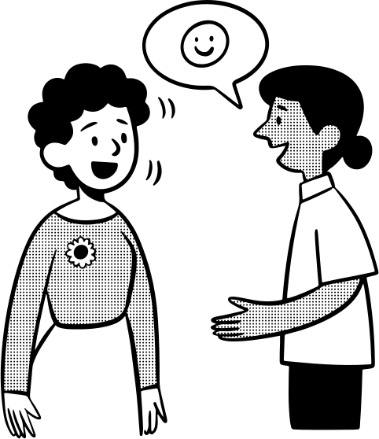

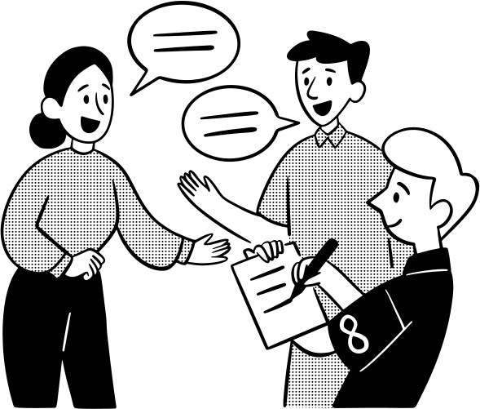

WAYS TO ASK CLARIFICATION
AMINOVA HILOLA

Slide 2

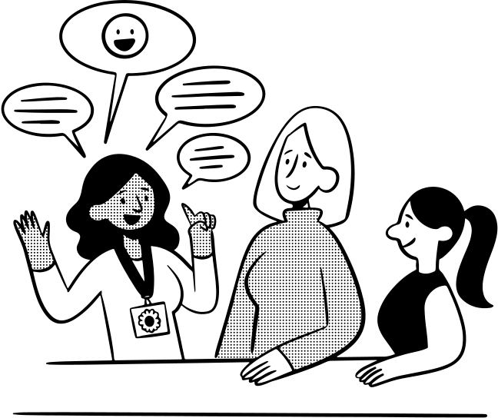
INTRODUCTION
First, what does “clarification” mean?
Clarification is when we ask someone to explain something more clearly, so we can fully understand. It’s an important part of communication because it helps prevent mistakes, saves time, and shows respect for the other person.
NEXT PAGE

Slide 3


SITUATIONS WHERE WE ASK FOR CLARIFICATION
There are many situations where we need clarification: in class when a teacher gives instructions, at work when a supervisor gives a task, or in everyday conversation when someone uses a word or idea we don’t know. In all these cases, it’s okay—and actually very smart—to ask for clarification.

Slide 4


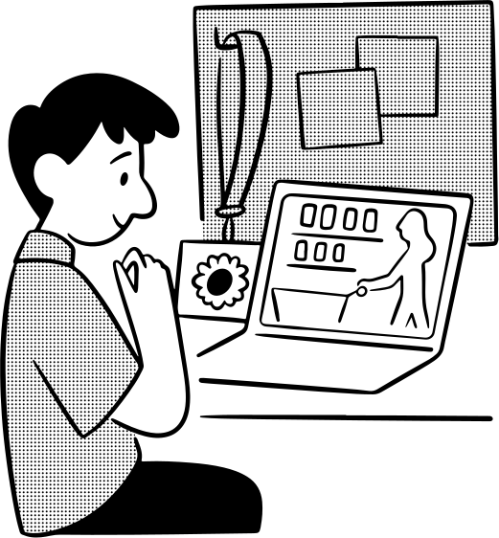

WAYS TO ASK FOR CLARIFICATION (CORE PART)
Here’s where you give examples. You can break it into three types: direct questions, rephrasing/paraphrasing, and nonverbal cues.

Slide 5

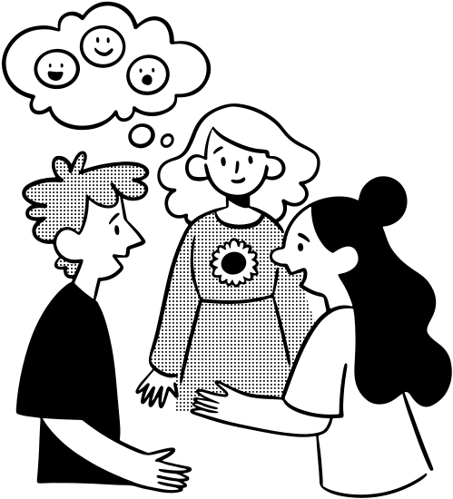
DIRECT QUESTIONS (EXAMPLES)
The first way is direct questions. This is the simplest and clearest approach. For example:
“Could you explain that again, please?”
“I’m not sure I understood. Can you clarify?”
“What do you mean by…?”
NEXT PAGE

Slide 6
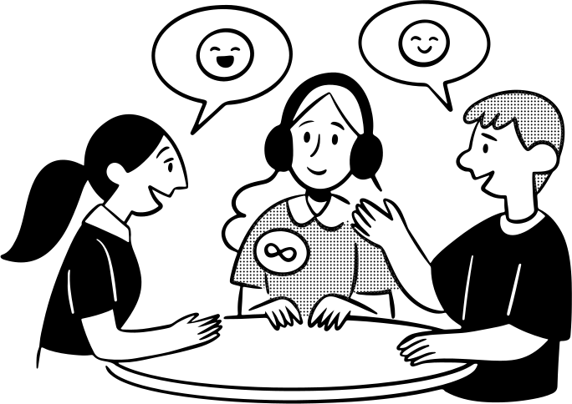


The second way is rephrasing or paraphrasing. This means repeating back what you understood, so the other person can confirm or correct you. For example:
“So you’re saying we should finish by Friday, right?”
“Just to make sure I understand, you want me to do A before B?”
REPHRASING PARAPHRASING

Slide 7
NONVERBAL CUES
The third way is nonverbal cues. Sometimes just a confused facial expression, raising your hand, or pausing can signal that you need more explanation. These small gestures can encourage the speaker to slow down or give more detail.

Slide 8
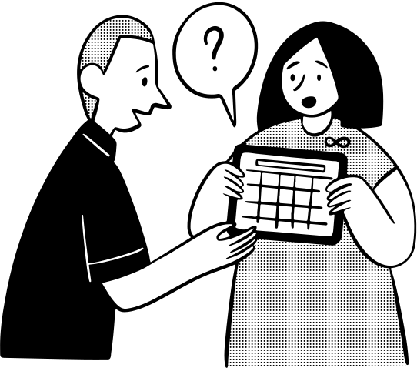
TIPS FOR ASKING POLITELY
When asking for clarification, it’s important to be polite. Use words like “please” and “could you.” Be specific about what’s unclear, and always listen carefully to the response. This shows respect and makes communication smoother.
NEXT PAGE

Slide 9
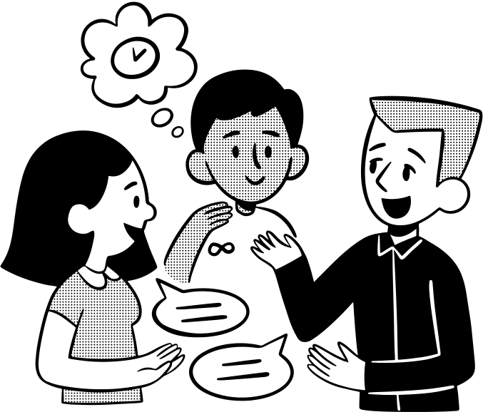

CONCLUSION
In conclusion, asking for clarification is not a weakness — it’s a skill. By using direct questions, paraphrasing, and nonverbal cues, we can communicate more effectively, avoid misunderstandings, and build better relationships.

Slide 10
THANK YOU

